Slide 1
ANLY 5332
Department of Information Systems and Analytics
McCoy College of Business Administration
Texas State University
Modeling and Linear Programming

Slide 2
Outline
Formulating Linear Programming Models
  Surviving in an Island (not in the textbook)
  Case: Wyndor Glass Co. Product Mix (Chapter 2.3)
  Linear Programming Terminology (Chapter 2.3)
Graphical Solution Method (Chapter 2.4)
Linear Programming Properties (not in the textbook)
Further Cases on Algebraic Modeling
  Case: Profit and Gambit Co. Advertising Mix (Chapter 2.7)
  Case: Case 2-3 – Staffing a Call Center (page 62)

Slide 3
Outline
Formulating Linear Programming Models
  Surviving in an Island (not in the textbook)
  Case: Wyndor Glass Co. Product Mix (Chapter 2.3)
  Linear Programming Terminology (Chapter 2.3)
Graphical Solution Method (Chapter 2.4)
Linear Programming Properties (not in the textbook)
Further Cases on Algebraic Modeling
  Case: Profit and Gambit Co. Advertising Mix (Chapter 2.7)
  Case: Case 2-3 – Staffing a Call Center (page 62)

Slide 4
Formulating Linear Programming Models
It is also referred to as ‘algebraic modeling’
What do we need to formulate a linear programming problem?
  Have a problem!
  Steps to follow for algebraic modeling:
    Step 0: Gather data
    Step 1: Identify the variables
    Step 2: Define the objective function
    Step 3: Define the constraints
  Best way to learn is to do some examples….

Slide 5


Formulating Linear Programming Models
An Example: Surviving in an Island (not in the textbook)
Linear programming will save you!
  Suppose that you will be left in a deserted island
  You want to live as many days as you can to increase chance of rescue
  Fortunately (!), you can take a bag with you to the island
  What would you put into the bag?
  The bag can carry at most 50 lbs
  There is a limited set of items you can take
    Bread: You can survive for 2 days with 1 lb of bread
    Steak: You can survive for 5 days with 1 lb of steak (Memphis style grilled!)
    Chicken: You can survive for 3 days with 1 lb of chicken (fried!)
    Chocolate: You can survive for 6 days with 1 lb of chocolate
  How much of each item to take with you?

Slide 6
Formulating Linear Programming Models
An Example: Surviving in an Island (not in the textbook)
STEP 0: Know the problem and gather your data
  Your problem is to increase your chance of rescue by maximizing the number of days you survive
  You can have 1 bag, which can carry 50 lbs at most
  You can only put bread, steak, chicken and chocolate into your bag
  Each item enables you survive for a specific number of days for each pound you take
    →Bread: 2 days/lb
    →Steak: 5 days/lb
    →Chicken: 3days/lb
    →Chocolate: 6days/lb

Slide 7
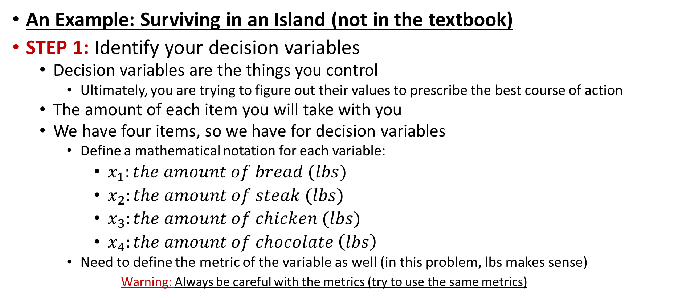
Formulating Linear Programming Models
An Example: Surviving in an Island (not in the textbook)
STEP 1: Identify your decision variables
  Decision variables are the things you control
    Ultimately, you are trying to figure out their values to prescribe the best course of action
  The amount of each item you will take with you
  We have four items, so we have for decision variables
    Define a mathematical notation for each variable:
      $x_{1}:the amount of bread (lbs)$
      $x_{2}:the amount of steak (lbs)$
      $x_{3}:the amount of chicken (lbs)$
      $x_{4}:the amount of chocolate \left(lbs\right)$
    Need to define the metric of the variable as well (in this problem, lbs makes sense)
  Warning: Always be careful with the metrics (try to use the same metrics)

Slide 8

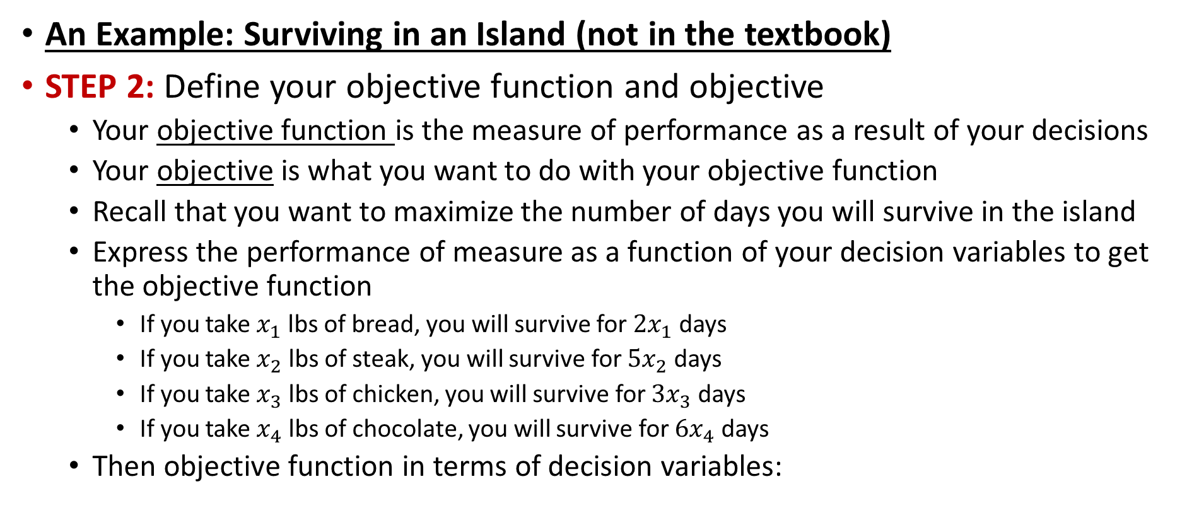

Formulating Linear Programming Models
An Example: Surviving in an Island (not in the textbook)
STEP 2: Define your objective function and objective
  Your objective function is the measure of performance as a result of your decisions
  Your objective is what you want to do with your objective function
  Recall that you want to maximize the number of days you will survive in the island
  Express the performance of measure as a function of your decision variables to get the objective function
    If you take $x_{1}$ lbs of bread, you will survive for ${2x}_{1}$ days
    If you take $x_{2}$ lbs of steak, you will survive for ${5x}_{2}$ days
    If you take $x_{3}$ lbs of chicken, you will survive for ${3x}_{3}$ days
    If you take $x_{4}$ lbs of chocolate, you will survive for ${6x}_{4}$ days
  Then objective function in terms of decision variables:
$$Maximize$$
$${2x}_{1}+{5x}_{2}+{3x}_{3}+{6x}_{4}$$

Slide 9

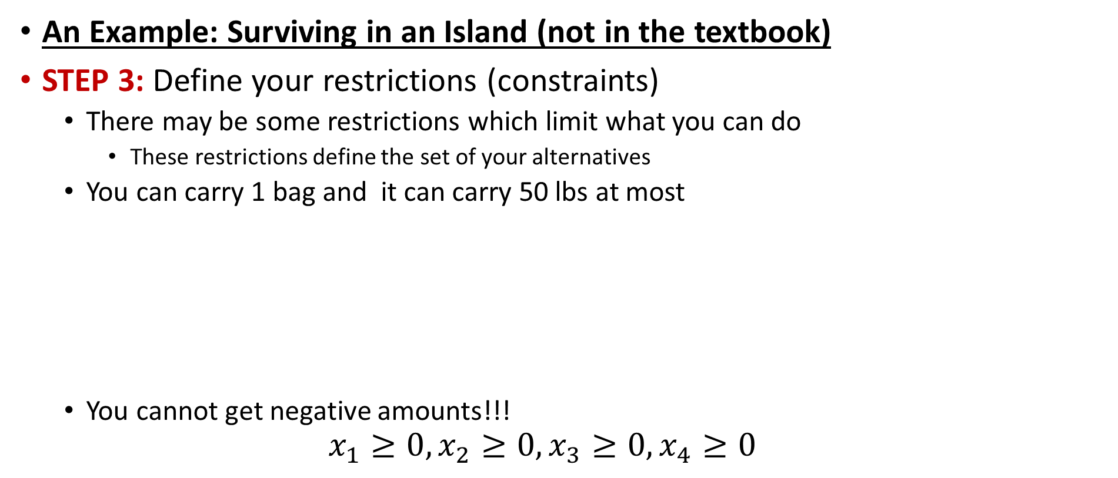


Formulating Linear Programming Models
An Example: Surviving in an Island (not in the textbook)
STEP 3: Define your restrictions (constraints)
  There may be some restrictions which limit what you can do
    These restrictions define the set of your alternatives
  You can carry 1 bag and it can carry 50 lbs at most
  You cannot get negative amounts!!!
  $$x_{1}≥0, x_{2}≥0,x_{3}≥0, x_{4}≥0$$
$$x_{1}+x_{2}+x_{3}+x_{4}$$
$$≤$$
$$50$$
Limit on how much you can carry
Total amount you are going to carry as a function of your decision variables
Note: Left-side and Right-side of a constraint should have the same metrics. It is wrong to say that $$ should be less than lbs

Slide 10


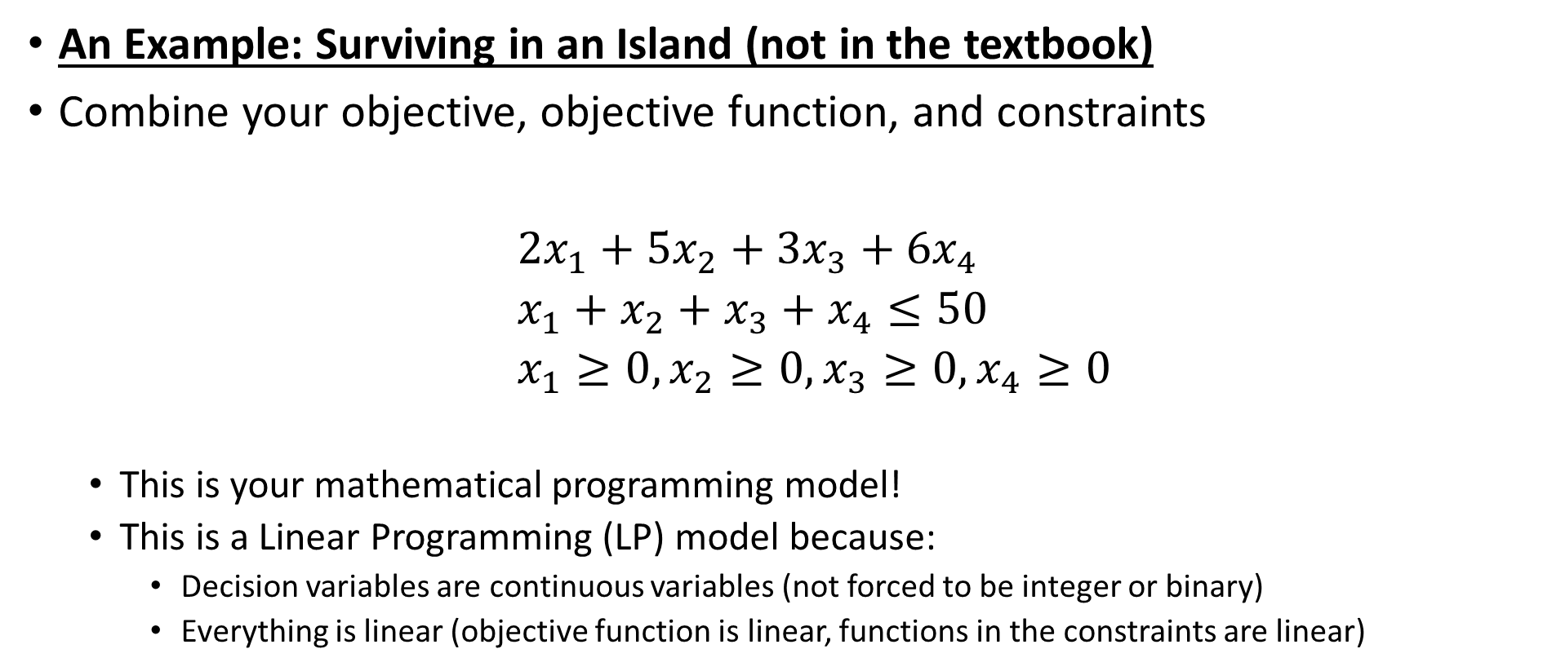

Formulating Linear Programming Models
An Example: Surviving in an Island (not in the textbook)
Combine your objective, objective function, and constraints
${2x}_{1}+{5x}_{2}+{3x}_{3}+{6x}_{4}$
  $x_{1}+x_{2}+x_{3}+x_{4}≤50$
  $x_{1}≥0, x_{2}≥0,x_{3}≥0, x_{4}≥0$
  This is your mathematical programming model!
  This is a Linear Programming (LP) model because:
    Decision variables are continuous variables (not forced to be integer or binary)
    Everything is linear (objective function is linear, functions in the constraints are linear)
$$Maximize$$
$$subject to$$

Slide 11

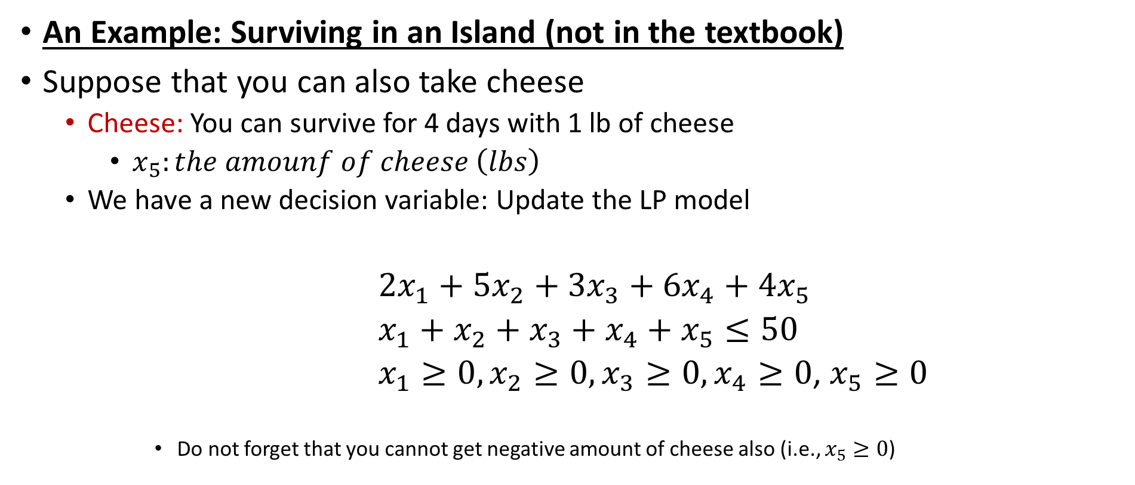

Formulating Linear Programming Models
An Example: Surviving in an Island (not in the textbook)
Suppose that you can also take cheese
  Cheese: You can survive for 4 days with 1 lb of cheese
    $x_{5}:the amounf of cheese \left(lbs\right)$
  We have a new decision variable: Update the LP model
${2x}_{1}+{5x}_{2}+{3x}_{3}+{6x}_{4}+{4x}_{5}$
  $x_{1}+x_{2}+x_{3}+x_{4}+x_{5}≤50$
  $x_{1}≥0, x_{2}≥0,x_{3}≥0, x_{4}≥0$, $x_{5}≥0$
      Do not forget that you cannot get negative amount of cheese also (i.e., $x_{5}≥0$)
$$Maximize$$
$$subject to$$

Slide 12
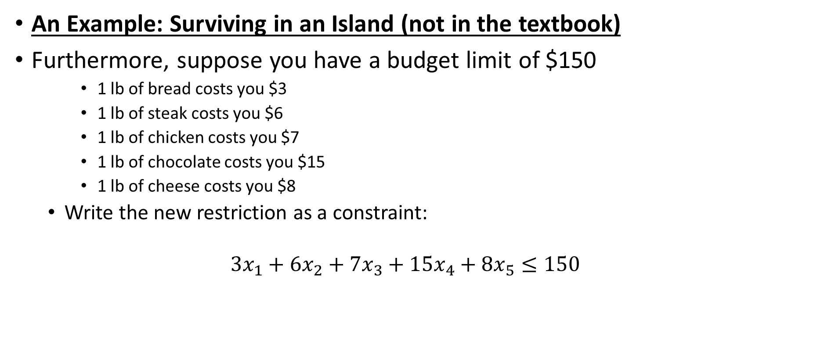
Formulating Linear Programming Models
An Example: Surviving in an Island (not in the textbook)
Furthermore, suppose you have a budget limit of $150
    1 lb of bread costs you $3
    1 lb of steak costs you $6
    1 lb of chicken costs you $7
    1 lb of chocolate costs you $15
    1 lb of cheese costs you $8
  Write the new restriction as a constraint:
  $$3x_{1}+{6x}_{2}+7x_{3}+15x_{4}+8x_{5}≤150$$
Limit on how much you can spend
Total money you are going to spend as a function of your decision variables

Slide 13
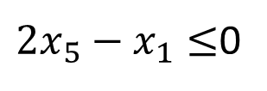

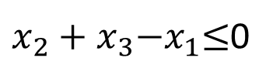
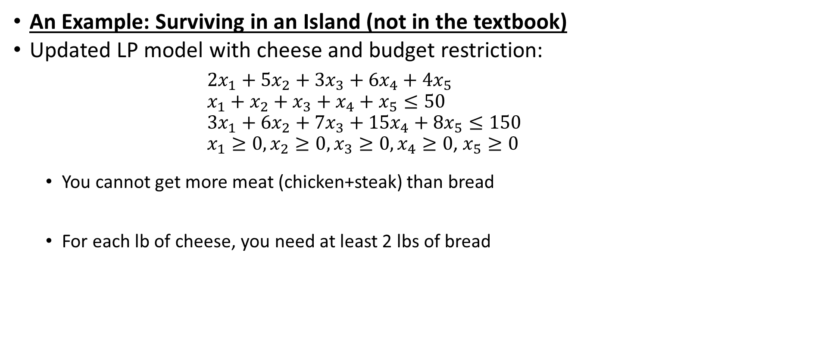


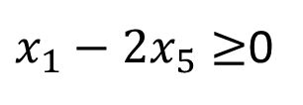

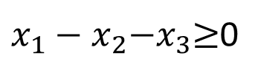
Formulating Linear Programming Models
An Example: Surviving in an Island (not in the textbook)
Updated LP model with cheese and budget restriction:
${2x}_{1}+{5x}_{2}+{3x}_{3}+{6x}_{4}+{4x}_{5}$
  $x_{1}+x_{2}+x_{3}+x_{4}+x_{5}≤50$
  $3x_{1}+{6x}_{2}+7x_{3}+15x_{4}+8x_{5}≤150$
  $x_{1}≥0, x_{2}≥0,x_{3}≥0, x_{4}≥0$, $x_{5}≥0$
  You cannot get more meat (chicken+steak) than bread
  For each lb of cheese, you need at least 2 lbs of bread
$$Maximize$$
$$subject to$$
$$x_{2}+x_{3}≤x_{1}$$
same as
$x_{2}+x_{3}{−x}_{1}≤$0
same as
$x_{1}−x_{2}{−x}_{3}≥$0
$${2x}_{5}≤x_{1}$$
same as
${2x}_{5}−x_{1}≤$0
same as
$x_{1}−{2x}_{5}≥$0

Slide 14
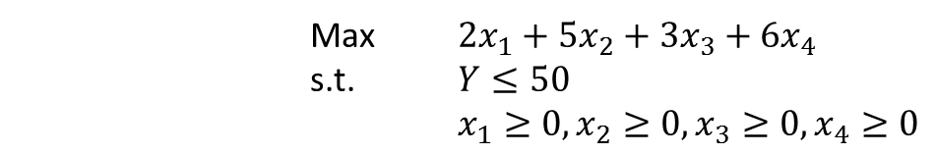
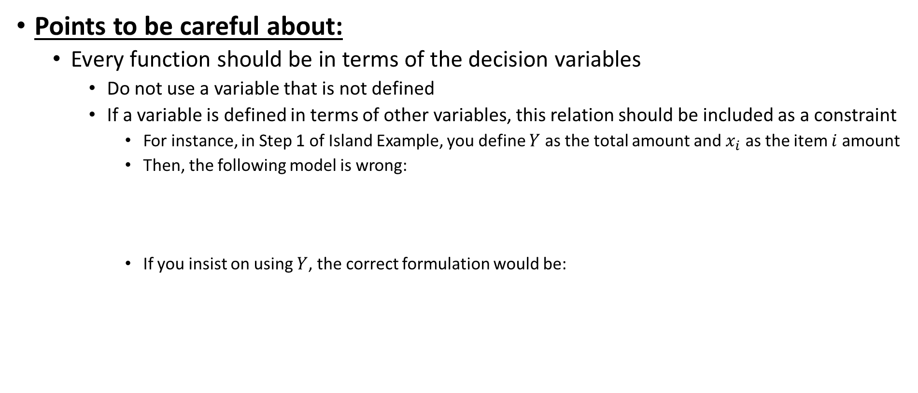
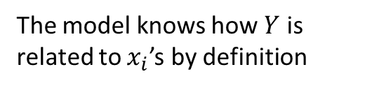
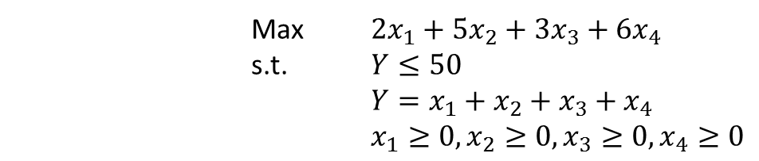
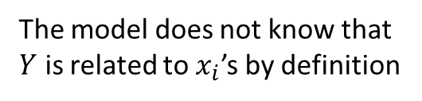
Formulating Linear Programming Models
Points to be careful about:
  Every function should be in terms of the decision variables
    Do not use a variable that is not defined
    If a variable is defined in terms of other variables, this relation should be included as a constraint
      For instance, in Step 1 of Island Example, you define $Y$ as the total amount and $x_{i}$ as the item $i$ amount
      Then, the following model is wrong:
      If you insist on using $Y$, the correct formulation would be:
Max ${2x}_{1}+{5x}_{2}+{3x}_{3}+{6x}_{4}$
  s.t. $Y≤50$
  $x_{1}≥0, x_{2}≥0,x_{3}≥0, x_{4}≥0$
The model does not know that $Y$ is related to $x_{i}$’s by definition
Max ${2x}_{1}+{5x}_{2}+{3x}_{3}+{6x}_{4}$
  s.t. $Y≤50$
  $Y=x_{1}+x_{2}+x_{3}+x_{4}$
  $x_{1}≥0, x_{2}≥0,x_{3}≥0, x_{4}≥0$
The model knows how $Y$ is related to $x_{i}$’s by definition

Slide 15

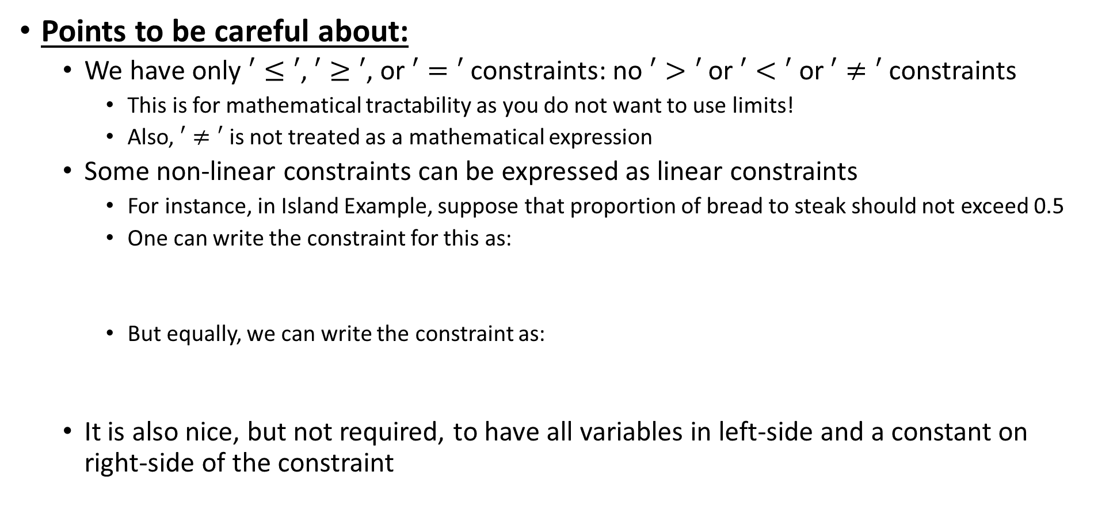


Formulating Linear Programming Models
Points to be careful about:
  We have only $′≤′$, $′≥′$, or $′=′$ constraints: no $′>′$ or $′<′$ or $′≠′$constraints
    This is for mathematical tractability as you do not want to use limits!
    Also, $′≠′$ is not treated as a mathematical expression
  Some non-linear constraints can be expressed as linear constraints
    For instance, in Island Example, suppose that proportion of bread to steak should not exceed 0.5
    One can write the constraint for this as:
    But equally, we can write the constraint as:
  It is also nice, but not required, to have all variables in left-side and a constant on right-side of the constraint
$$\frac{x_{1}}{x_{2}}≤0.5$$
This is not linear are variables are divided
$$x_{1}≤0.5x_{2}$$
same as
$$x_{1}−0.5x_{2}≤0$$
This is linear!

Slide 16
Formulating Linear Programming Models
Summary of algebraic modeling steps:
  Gather all of your data, know what they mean
  Identify your decision variables
  Identify your objective and objective function
  Identify your constraints
    Express your objective function and constraints in terms of your decision variables
    Steps 2 and 3 can change order

Slide 17
Formulating Linear Programming Models
Case: Wyndor Glass Co. Product-Mix Problem (Chapter 2.1):
  Case Description: The company uses three plants for its production operations
    Plant 1 produces aluminum frames
    Plant 2 produces wood frames
    Plant 3 produces the glass and assembles windows and doors
  The company plans to produce two new products
    A glass door with aluminum framing: each such door needs to go through Plants 1 and 3
    A wood-framed window: each such window needs to go through Plants 2 and 3
  The plants have limited capacities available to be used by these two new products
  What should be the product mix for these two new products to maximize the profit?
    Product mix: the number of units of each product produced per week
    So, it can be fractional number, say 2.5 per week, which means 10 per month

Slide 18
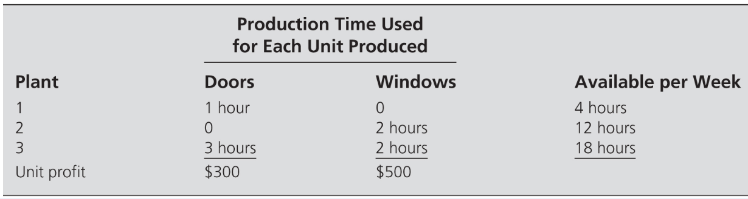
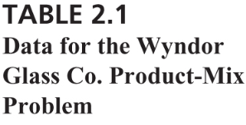
Formulating Linear Programming Models
Case: Wyndor Glass Co. Product-Mix Problem (Chapter 2.1):
STEP 0: Know the problem and gather your data
  Based on consultation with production, accounting, and facilities, we know
    Plant 1 has 4 hours; Plant 2 has 12 hours; and Plant 3 has 18 hours availability per week
    Each new door requires 1 hour from Plant 1 and 3 hours from Plant 3 to be produced
    Each new window requires 2 hours from Plant 2 and 2 hours from Plant 3 to be produced
    Unit profit for doors is $300 and unit profit for windows is $500
    As the new product development management, you want to determine the production rate (# of units produced per week) for each new product so as to maximize the profit (weekly) generated
      It is assumed that you will sell what is being produced

Slide 19
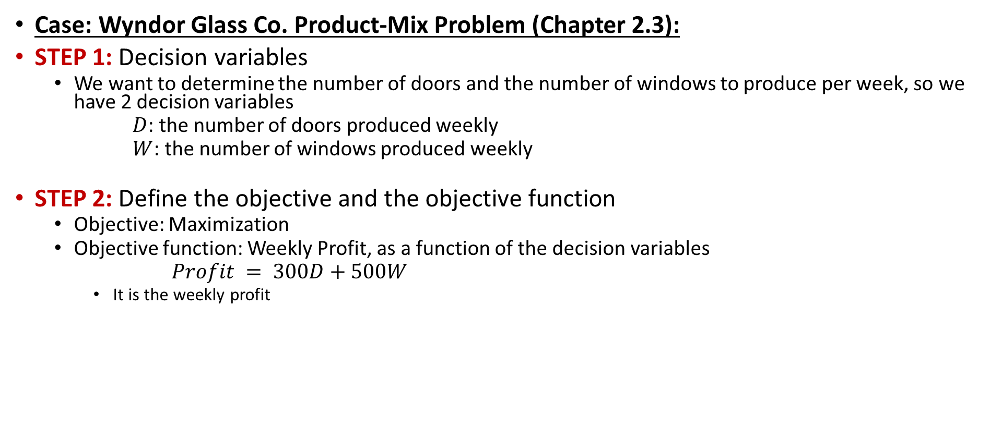
Formulating Linear Programming Models
Case: Wyndor Glass Co. Product-Mix Problem (Chapter 2.3):
STEP 1: Decision variables
  We want to determine the number of doors and the number of windows to produce per week, so we have 2 decision variables
      $D$: the number of doors produced weekly
      $W$: the number of windows produced weekly
STEP 2: Define the objective and the objective function
  Objective: Maximization
  Objective function: Weekly Profit, as a function of the decision variables
  $Profit = 300D+500W$
    It is the weekly profit

Slide 20

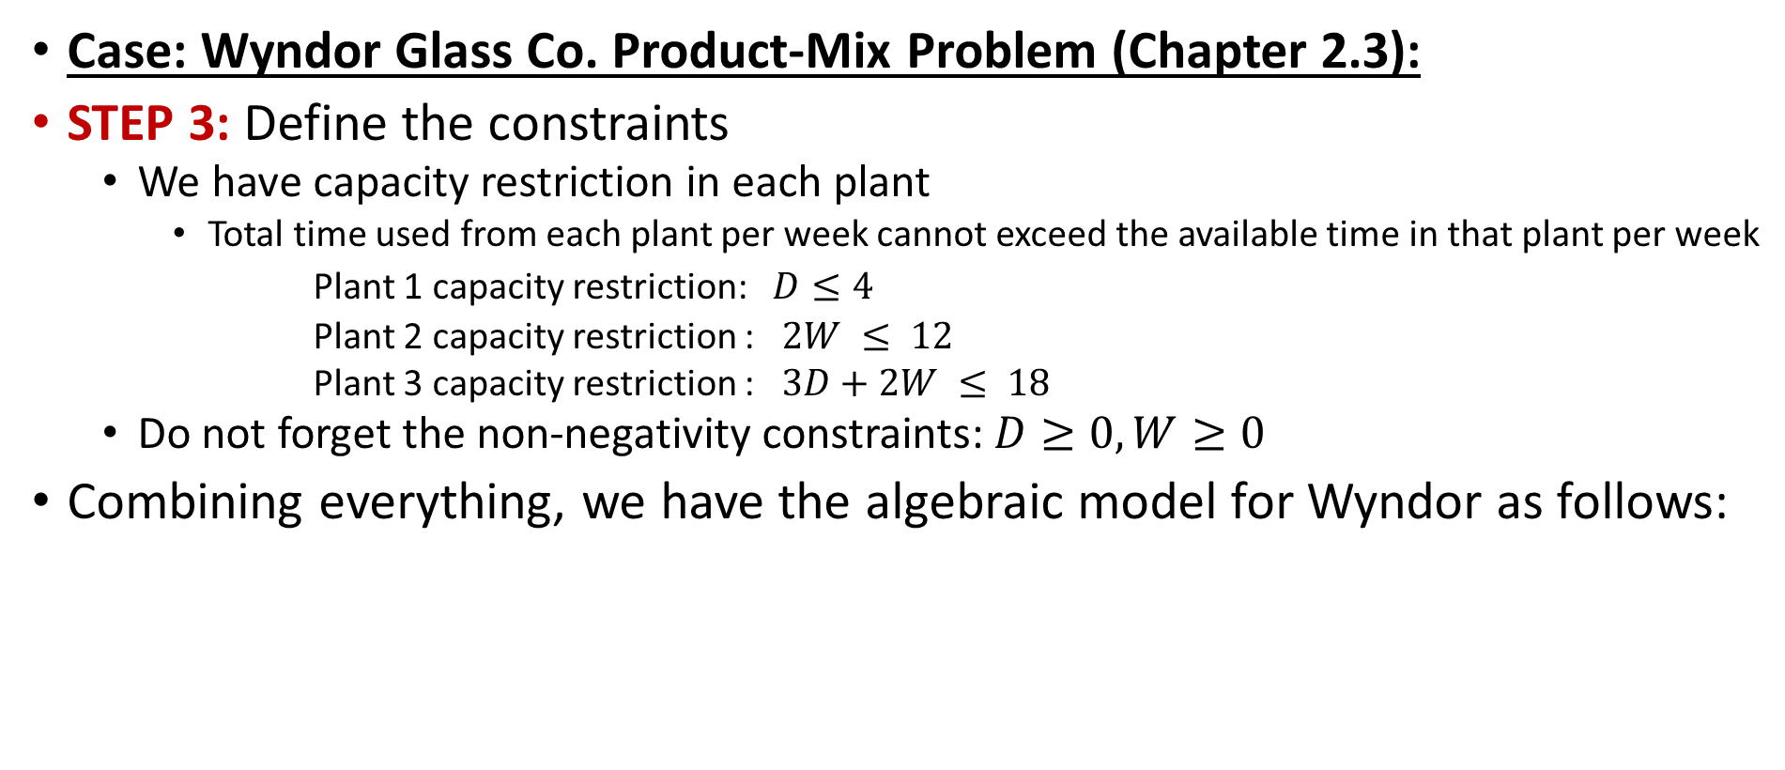



Formulating Linear Programming Models
Case: Wyndor Glass Co. Product-Mix Problem (Chapter 2.3):
STEP 3: Define the constraints
  We have capacity restriction in each plant
    Total time used from each plant per week cannot exceed the available time in that plant per week
  Plant 1 capacity restriction: $D≤4$
  Plant 2 capacity restriction : $2W ≤ 12$
  Plant 3 capacity restriction : $3D+2W ≤ 18$
  Do not forget the non-negativity constraints: $D≥0, W≥0$
Combining everything, we have the algebraic model for Wyndor as follows:
  $$Maximize 300D+500W$$
$$subject to D ≤ 4$$
$$2W≤ 12$$
  $3D+2W ≤ 18$
  $D≥0, W ≥0$

Slide 21
Formulating Linear Programming Models
Linear Programming Terminology (Chapter 2.3):
  Decision Variables: things we control
  Objective function: measure of performance
  Non-negativity constraints are non-negativity conditions on the variables
  Functional constraints: restrictions we have
  Parameters: constants we use in the objective function and constraint definitions
  Solution: any choice of values for the decision variables
    A feasible solution is one that satisfies all the constraints
    An infeasible solution violates at least one constraint
    An optimal solution is one of the best feasible solutions

Slide 22
Outline
Formulating Linear Programming Models
  Surviving in an Island (not in the textbook)
  Case: Wyndor Glass Co. Product Mix (Chapter 2.3)
  Linear Programming Terminology (Chapter 2.3)
Graphical Solution Method (Chapter 2.4)
Linear Programming Properties (not in the textbook)
Further Cases on Algebraic Modeling
  Case: Profit and Gambit Co. Advertising Mix (Chapter 2.7)
  Case: Case 2-3 – Staffing a Call Center (page 62)

Slide 23
Graphical Solution Method
So far we have discussed how to formulate LP models
How about solving them?
  We will learn Spreadsheet modeling and Excel solver later
Simple LP models can be solved graphically
  Simple LP model: only 2 decision variables!
The steps of the method:
  Graph the constraints to see which points satisfy all constraints (i.e., graph the feasible points)
  Graph iso-lines of the objective function (objective function lines)
  Use iso-lines to find the optimal solution(s)

Slide 24
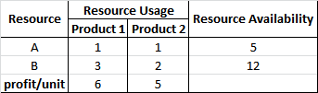
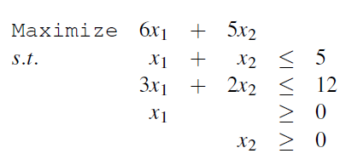
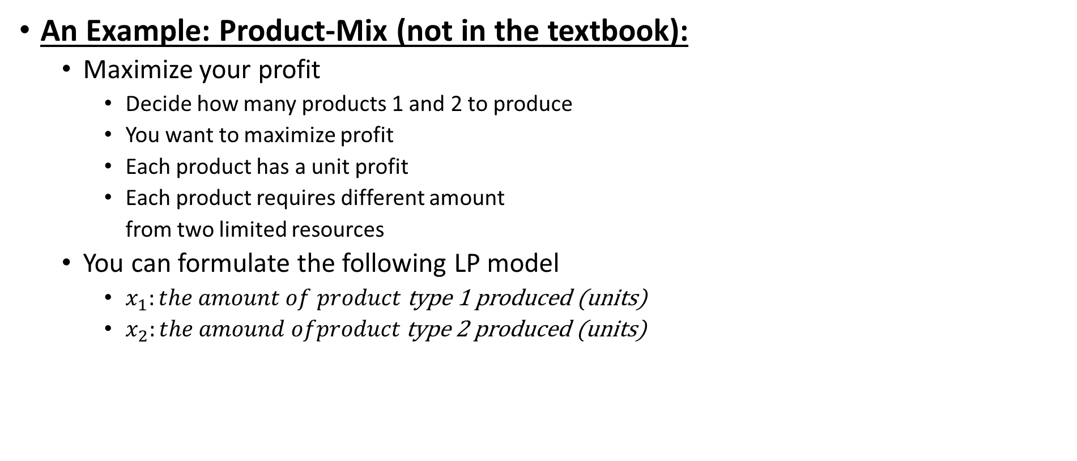
Graphical Solution Method
An Example: Product-Mix (not in the textbook):
  Maximize your profit
    Decide how many products 1 and 2 to produce
    You want to maximize profit
    Each product has a unit profit
    Each product requires different amount
    from two limited resources
  You can formulate the following LP model
    $x_{1}:the amount of product$ type 1 produced (units)
    $x_{2}:the amound ofproduct \text{type}\text{ 2 }\text{produced}$ (units)
Total profit
Resource A limit
Resource B limit
Non-negativity

Slide 25
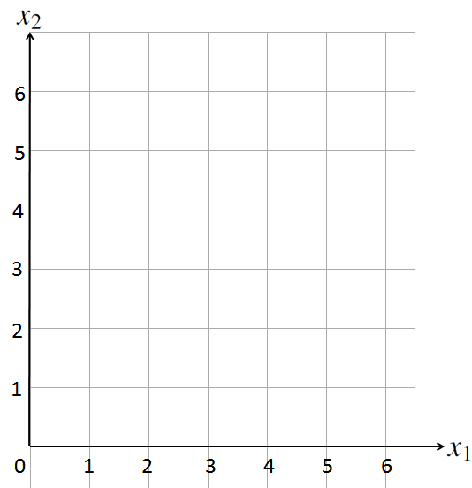
Graphical Solution Method
First, draw your decision variables as the axes of your graph

Slide 26
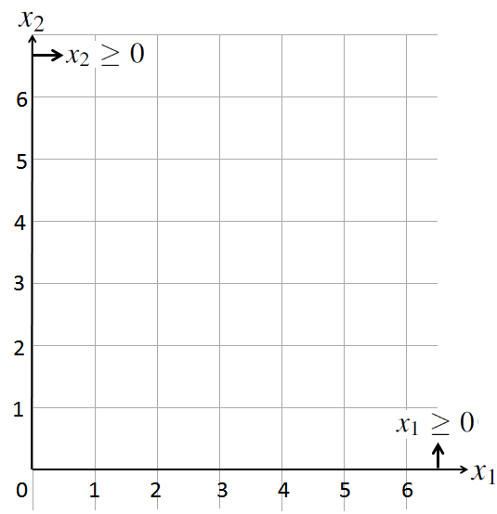
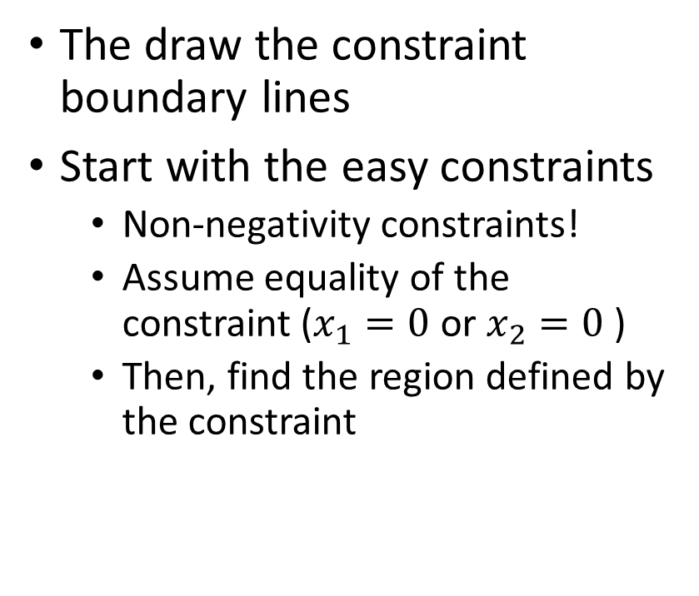
Graphical Solution Method
The draw the constraint boundary lines
Start with the easy constraints
  Non-negativity constraints!
  Assume equality of the constraint ($x_{1}=0$ or $x_{2}=0$ )
  Then, find the region defined by the constraint

Slide 27
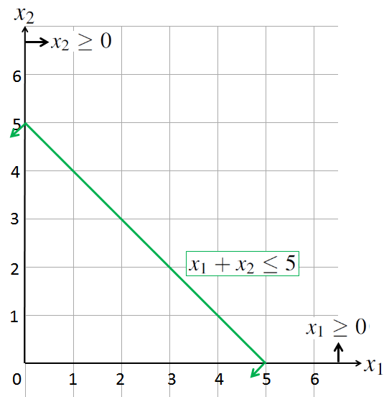
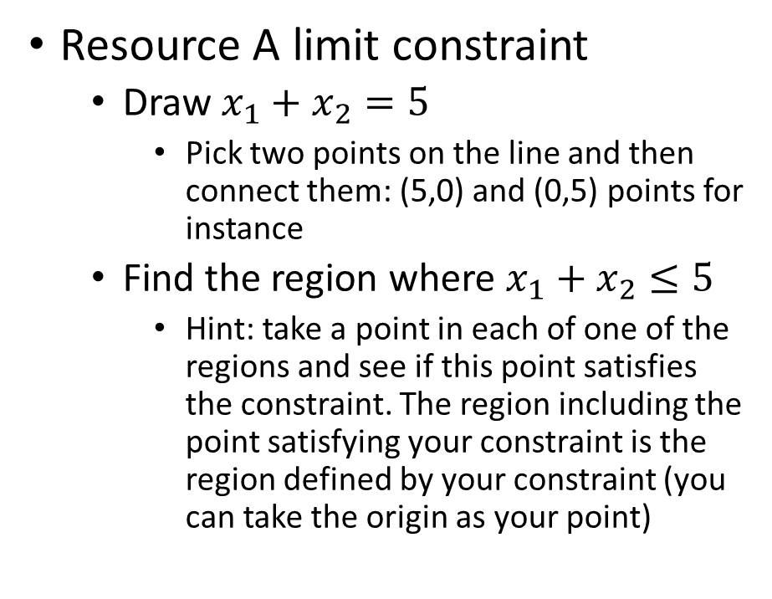
Graphical Solution Method
Resource A limit constraint
  Draw $x_{1}+x_{2}=5$
    Pick two points on the line and then connect them: (5,0) and (0,5) points for instance
  Find the region where $x_{1}+x_{2}≤5$
    Hint: take a point in each of one of the regions and see if this point satisfies the constraint. The region including the point satisfying your constraint is the region defined by your constraint (you can take the origin as your point)

Slide 28
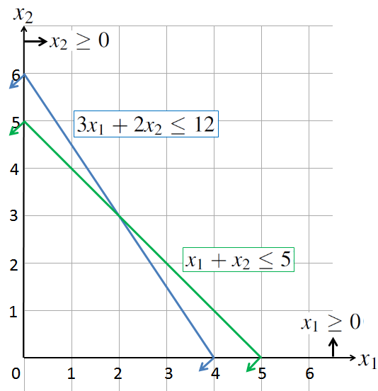

Graphical Solution Method
Resource B limit constraint
  Draw ${3x}_{1}+{2x}_{2}=1$2
  Find the region where ${3x}_{1}+{2x}_{2}≤1$2

Slide 29
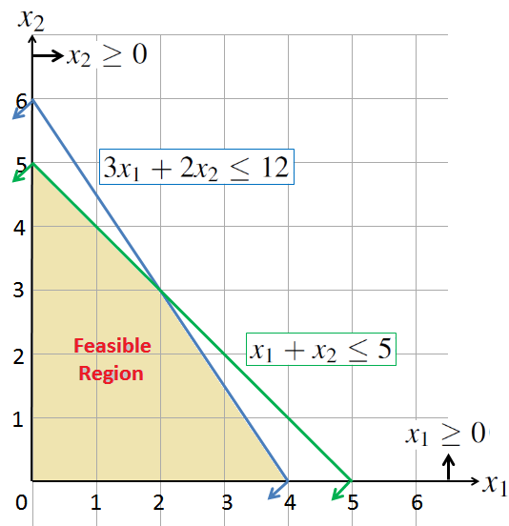
Graphical Solution Method
Define the feasible region
  It is the region defined by the intersection of all of your constraints
  It includes all of the feasible solutions to your LP model

Slide 30
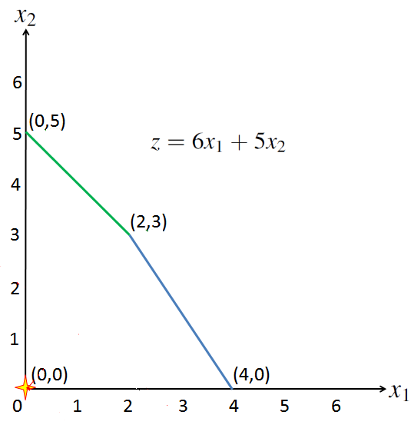



Graphical Solution Method
Improvement Direction

Slide 31
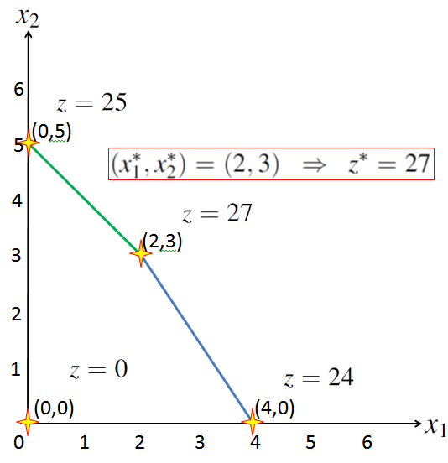
Graphical Solution Method
If there is an optimal solution, at least one of the corner solutions will be optimal!
  Graph the constraints
  Define your feasible region
  Draw iso-lines until you leave feasible region
  Choose the best corner point if you can (when the feasible region is bounded, you can!)
Further discussion on optimal solution and corner point relation will be given in LP Properties section.

Slide 32




Graphical Solution Method
Case: Wyndor Glass Co. Product-Mix Problem (Chapter 2.4):
  Recall the Wyndor Glass Co. Product-mix problem
    D: number of doors to produce per week
    W: number of windows to produce per week
Total profit
  $$Maximize 300D+500W$$
$$subject to D ≤ 4$$
Plant 1 availability
$$2W≤ 12$$
Plant 2 availability
  $3D+2W ≤ 18$
Plant 3 availability
  $D≥0, W ≥0$
Non-negativity

Slide 33
Graphical Solution Method
Case: Wyndor Glass Co. Product-Mix Problem (Chapter 2.4):
  Graphical solution of the Wyndor Glass Co. Product-Mix problem

Slide 34
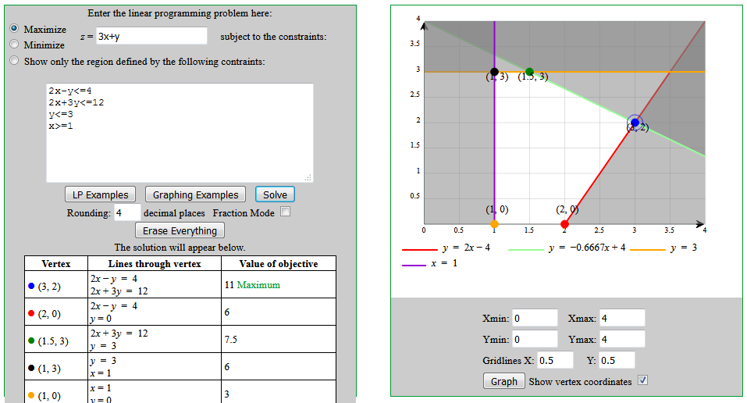
Graphical Solution Method
Summary:
  Draw the constraint boundary line for each constraint. Use the origin (or any point not on the line) to determine which side of the line is permitted by the constraint.
  Find the feasible region by determining where all constraints are satisfied simultaneously.
  Determine the slope of one objective function line (iso-line). All other objective function lines will have the same slope.
  Move a straight edge with this slope through the feasible region in the direction of improving values of the objective function. Stop at the last instant that the straight edge still passes through a point in the feasible region. This line given by the straight edge is the optimal objective function line.
  A feasible point on the optimal objective function line is an optimal solution.
An online tool:
  https://www.zweigmedia.com/utilities/lpg/index.html?lang=en
    Need to use X and Y as the variables
    Only works for models with 2 variables

Slide 35
Outline
Formulating Linear Programming Models
  Surviving in an Island (not in the textbook)
  Case: Wyndor Glass Co. Product Mix (Chapter 2.3)
  Linear Programming Terminology (Chapter 2.3)
Graphical Solution Method (Chapter 2.4)
Linear Programming Properties (not in the textbook)
Further Cases on Algebraic Modeling
  Case: Profit and Gambit Co. Advertising Mix (Chapter 2.7)
  Case: Case 2-3 – Staffing a Call Center (page 62)

Slide 36
Linear Programming Properties
Recall that a linear programming (LP) model has two main assumptions:
  Divisibility Assumption of Linear Programming:
    Decision variables in a LP model are allowed to have any values, including fractional values, that satisfy the functional and non-negativity constraints. Thus, these variables are not restricted to just integer or binary values.
    If violated, you do not have a LP model
  Proportionality Assumption of Linear Programming:
    The contribution of each decision variable to the value of the objective function and the constraint functions is proportional to the level of the decision variable. In other words, the terms in the objective function and constraint functions involving a decision variable consist of a coefficient times the decision variable.
    That is, every function in the model is a linear function of the decision variables.
These two assumptions lead to a very important property:
  If there is an optimum solution of a LP model, then there is a feasible corner point solution (algebraically referred to as basic feasible solution) that is optimum

Slide 37
Linear Programming Properties
If there is an optimum solution of a LP model, then there is a feasible corner point solution that is optimum
  Therefore, in the graphical solution method, if we know that there is an optimum solution, we can just compare the corner points and choose one of the best ones
  But it is possible that there is not any optimum solution or more than one optimum solutions
An LP model can have one of the four following cases:
  Infeasibility: No feasible solutions!
  Unique optimal solution: Only one feasible solution is optimum
  Multiple optimal solutions (alternative optima): More than one feasible solutions that are optimum
  Unboundedness: There is always a better feasible solution

Slide 38
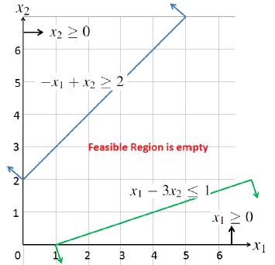
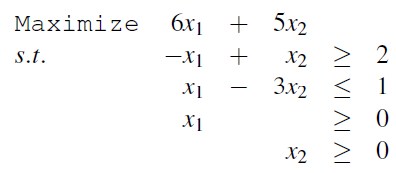
Linear Programming Properties
Infeasibility:
  Consider the following LP model:
  The feasible region is empty
  That is, no solution satisfies all of the constraints (i.e., there is no feasible solution)
    So, by definition, there does not exist an optimal solution
    Optimal solution is the best feasible solution: No feasible solution → no optimal solution
  In practice, this case typically occurs if something is wrong with the model or problem settings: so recheck your model, data, and settings
Practice!

Slide 39
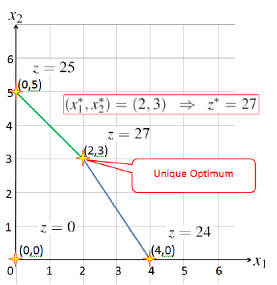
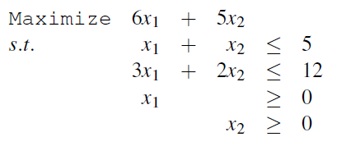
Linear Programming Properties
Unique Optimum:
  Consider the following LP model from slide # 29:
  The feasible region is not empty
  All of the points in the feasible region are feasible solutions
  And we have a single optimal solution
Graph

Slide 40
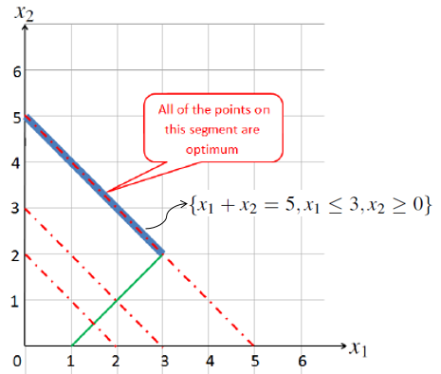
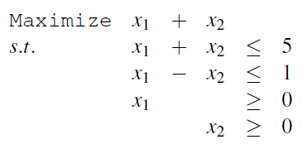
Linear Programming Properties
Alternative Optima:
  Consider the following LP model:
  The feasible region is not empty
  There are many feasible solutions
  Also, there are many optimal solutions
    But still there are corner points that are also optimum!
  This case typically occurs when a constraint line is parallel to objective function lines
Graph

Slide 41
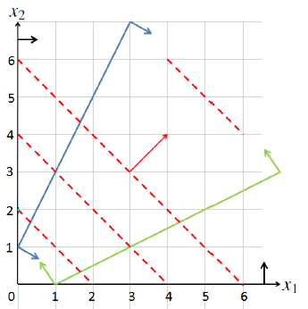
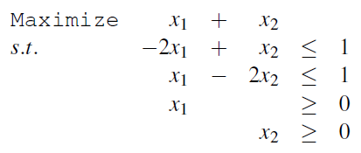
Linear Programming Properties
Unboundedness:
  Consider the following LP model:
  The feasible region is not empty
  The feasible region is not bounded (expands continuously)
  You can increase the objective function value continuously within the feasible region
    So, there is always a better feasible solution, thus no ‘best’ optimal solution
  In practice, this case typically occurs if something is wrong with the model or problem
Graph

Slide 42
Linear Programming Properties
Summary:
  The feasible region can be:
    Empty → Then, the LP model is infeasible
    Non-empty and bounded → Then, the LP model either has unique optimum or alternative optima
    Non-empty and unbounded → Then, the LP model can have unique optimum, alternative optima, or unboundedness
  With the graphical solution method, after determining the feasible region
    If the feasible region is non-empty and bounded, just compare the objective function values of the corner-points, and pick one of the best corner points as an optimal solution
    If the feasible region is non-empty and unbounded, be careful and draw objective function lines to see if the model is unbounded or not

Slide 43
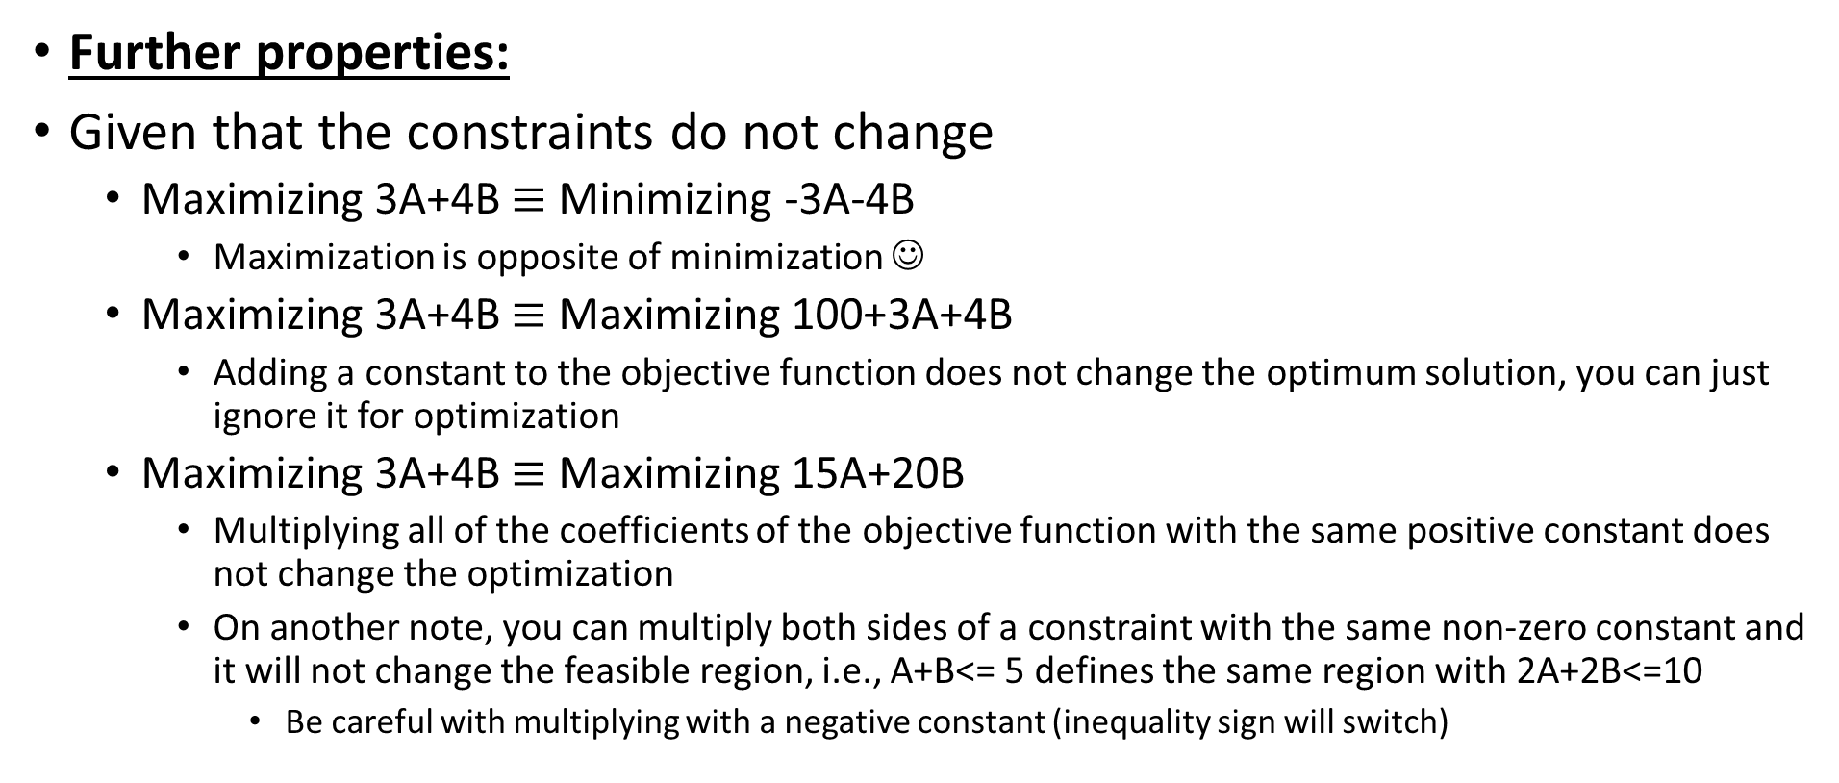
Linear Programming Properties
Further properties:
Given that the constraints do not change
  Maximizing 3A+4B $≡$ Minimizing -3A-4B
    Maximization is opposite of minimization ☺
  Maximizing 3A+4B $≡$ Maximizing 100+3A+4B
    Adding a constant to the objective function does not change the optimum solution, you can just ignore it for optimization
  Maximizing 3A+4B $≡$ Maximizing 15A+20B
    Multiplying all of the coefficients of the objective function with the same positive constant does not change the optimization
    On another note, you can multiply both sides of a constraint with the same non-zero constant and it will not change the feasible region, i.e., A+B<= 5 defines the same region with 2A+2B<=10
      Be careful with multiplying with a negative constant (inequality sign will switch)

Slide 44
Linear Programming Properties
Further properties:
LP models are polynomially solvable
  That is, they are relatively easy to solve
  Simplex Method is a very popular method to solve LP problems
    If an optimum solution exists to an LP problem, then there exists an optimum corner solution (this is true for any LP)
      Start with a corner solution, move to a better adjacent corner solution (there are finite corner solutions)
      Repeat this until you cannot find a better adjacent corner solution
      http://en.wikipedia.org/wiki/Simplex_algorithm
    There are educational app.s that use simplex: Simplex, Simplex Calculator, Simplex Tutor
  Karmarkar’s (interior-point) algorithm and Ellipsoid Method are other ways to solve LP models (wiki them to have a look)

Slide 45
Linear Programming Properties
Further properties:
There are many software for solving LP models
They mostly use Simplex type of algorithms
  We will learn how to solve LP models using Excel
  Excel solver uses Simplex Algorithm
Other software
  Python has a modeling language to solve LP models (PuLP)
  CPLEX (one of the best solvers for LP models)
  Matlab has a function to solve LP models (linprog)
  Optimization software can solve LP models
    GAMS, Xpress, Lindo, Lingo, AMPLE

Slide 46
Outline
Formulating Linear Programming Models
  Surviving in an Island (not in the textbook)
  Case: Wyndor Glass Co. Product Mix (Chapter 2.3)
  Linear Programming Terminology (Chapter 2.3)
Graphical Solution Method (Chapter 2.4)
Linear Programming Properties (not in the textbook)
Further Cases on Algebraic Modeling
  Case: Profit and Gambit Co. Advertising Mix (Chapter 2.7)
  Case: Case 2-3 – Staffing a Call Center (page 62)

Slide 47
Further Examples on Algebraic Modeling
Case: Profit & Gambit Co. Advertising-Mix Problem (Chapter 2.7):
  Case Description: The company produces cleaning products for home use and the company plans to undertake an advertising campaign that will focus on:
    A spray prewash stain remover.
    A liquid laundry detergent.
    A powder laundry detergent
  The campaign will use both television and print media
  The general goal is to increase sales of these products.
  Management has set the following goals for the campaign:
    Sales of the stain remover should increase by at least 3%.
    Sales of the liquid detergent should increase by at least 18%.
    Sales of the powder detergent should increase by at least 4%.
  How much should they advertise in each medium to meet the sales goals at a minimum total cost?

Slide 48
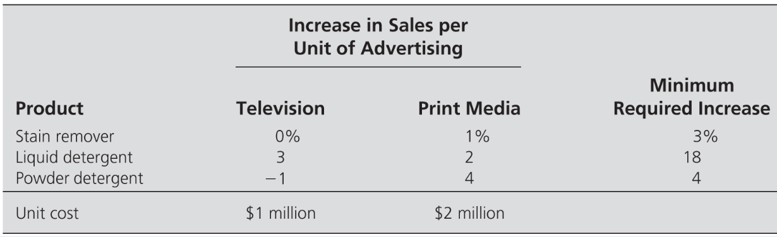
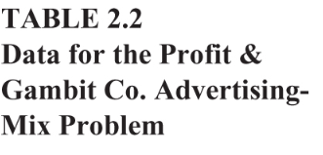
Further Examples on Algebraic Modeling
Case: Profit & Gambit Co. Advertising-Mix Problem (Chapter 2.7):
STEP 0: Know the problem and gather your data
  Based on estimations on effects of advertising on sales, the company goals, and the charges disclosed by the advertising outlets, we have:
    Management’s goal is to determine how much to advertise in each medium to meet the sales goals at a minimum cost

Slide 49
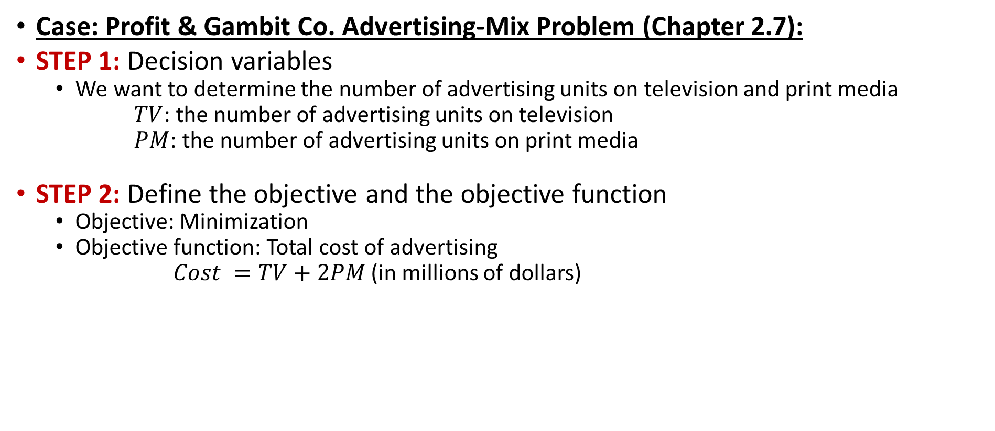
Further Examples on Algebraic Modeling
Case: Profit & Gambit Co. Advertising-Mix Problem (Chapter 2.7):
STEP 1: Decision variables
  We want to determine the number of advertising units on television and print media
      $TV$: the number of advertising units on television
      $PM$: the number of advertising units on print media
STEP 2: Define the objective and the objective function
  Objective: Minimization
  Objective function: Total cost of advertising
  $Cost =TV+2PM$ (in millions of dollars)

Slide 50





Further Examples on Algebraic Modeling
Case: Profit & Gambit Co. Advertising-Mix Problem (Chapter 2.7):
STEP 3: Define the constraints
  We have sales goals
    Sale increase for each product should be at least the targeted percent)
  Stain remover increased sales: $PM≥3$
  Liquid detergent increased sales: $3TV+2PM≥ 18$
  Powder detergent increased sales: $−TV+4PM≥4$
  Do not forget the non-negativity constraints: $TV≥0, PM≥0$
Combining everything, we have the algebraic model as follows:
  $$Minimize TV+2PM$$
$subject to PM≥3$
  $3TV+2PM≥ 18$
  $−TV+4PM≥4$
  $TV≥0, PM≥0$

Slide 51
Further Examples on Algebraic Modeling
Case: Profit & Gambit Co. Advertising-Mix Problem (Chapter 2.7):
Graphical Solution Method: Since the model has two decision variables, we can solve it graphically!
Note: Even the feasible region is an unbounded area, the LP model itself has a unique optimal solution:
Improvement Direction

Slide 52
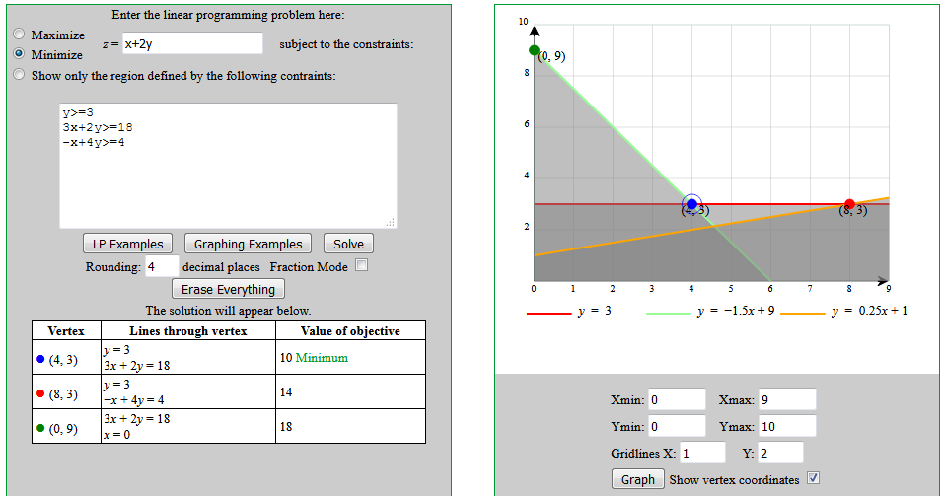
Further Examples on Algebraic Modeling
Case: Profit & Gambit Co. Advertising-Mix Problem (Chapter 2.7):
Graphical Solution Method: Using the online tool mentioned
  https://www.zweigmedia.com/utilities/lpg/index.html?lang=en

Slide 53
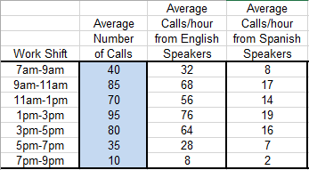
Further Examples on Algebraic Modeling
Case: Case 2-3 Staffing a Call Center (page 62):
  Case Description: California Children’s Hospital needs to staff in the call center
  A consulting company estimated average
  number of calls received (80% from English
  speakers and 20% from Spanish speakers)
  An agent can process 6 calls per hour
  We’ll focus on hiring English speaking agents
  There are two types of agents
    Full-time agent:
      Works 8 consecutive hours, 2-hour shifts between answering calls and completing paperwork
      Can start at 7am or 9am or 11am or 1pm
    Part-time agent:
      Works 4 consecutive hours, only answers calls
      Can start at 3pm or 5pm

Slide 54

Further Examples on Algebraic Modeling
Case: Case 2-3 Staffing a Call Center (page 62):
  Case Description: Since we know the number of average
  calls/hour from English speakers and we know that each
  operator can answer 6 calls per hour, we can calculate the
  number of agents needed to be available to answer calls
  during each work shift as shown in the table
  Agents are paid $10/hour before 5pm and $12/hour after 5pm
  The problem is to determine the number of agents (full-time and part-time) to hire for each possible shift and how the full-time agents should work so as to minimize the total costs to assure that at least the needed number of agents are available to answer calls!

Slide 55
Further Examples on Algebraic Modeling
Case: Case 2-3 Staffing a Call Center (page 62):
STEP 0: Know the problem and gather your data
  We know the number of agents needed during each work-shift
  Calculate how much each agent will cost depending on their start time
    A full-time agent starting at 7am: Finishes by 3pm, so will cost 8*$10=$80
    A full-time agent starting at 9am: Finishes by 5pm, so will cost 8*$10 =$80
    A full-time agent starting at 11am: Finishes by 7pm, so will cost 6*$10+2*$12=$84
    A full-time agent starting at 1pm: Finishes by 9pm, so will cost 4*$10+4*$12=$88
    A part-time agent starting at 3pm: Finishes by 7pm, so will cost 2*$10+2*$12=$44
    A part-time agent starting at 5pm: Finishes by 9pm, so will cost 4*$12=$48

Slide 56


Further Examples on Algebraic Modeling
Case: Case 2-3 Staffing a Call Center (page 62):
STEP 1: Decision variables
  We want to determine the number of full-time and part-time agents to hire for each start time. Also, a full-time agent can start her shift with paperwork or answering calls
  So, we have 8 decisions related to full-time agents
  We have 2 decisions related to part-time agents
$X_{1}$: # of full-time agents starting 7am with answering calls | $Y_{1}$: # of full-time agents starting 7am with paperwork
$X_{2}$: # of full-time agents starting 9am with answering calls | $Y_{2}$: # of full-time agents starting 9am with paperwork
$X_{3}$: # of full-time agents starting 11am with answering calls | $Y_{3}$: # of full-time agents starting 11am with paperwork
$X_{4}$: # of full-time agents starting 1pm with answering calls | $Y_{4}$: # of full-time agents starting 1pm with paperwork
$Z_{1}$: # of part-time agents starting 3pm
$Z_{2}$: # of part-time agents starting 5pm

Slide 57

Further Examples on Algebraic Modeling
Case: Case 2-3 Staffing a Call Center (page 62):
STEP 2: Define the objective and the objective function
  Objective: Minimization
  Objective function: Total cost of the agents
    We know how much each agent starting at each shift will cost
    We know the # of agents starting at each shift as a function of our decision variables
      For instance: ${(X}_{1}+Y_{1})$ is the # of full-time agents starting at 7am
    Then, we can write the total cost function
  $Cost =80{(X}_{1}+Y_{1})+80{(X}_{2}+Y_{2})+84{(X}_{3}+Y_{3})+88{(X}_{4}+Y_{4})+44Z_{1}+44Z_{2}$

Slide 58
Further Examples on Algebraic Modeling
Case: Case 2-3 Staffing a Call Center (page 62):
STEP 3: Define the constraints
  The main restriction we have is that the number of agents available to answer calls during any 2-hour work shift should be at least what is needed during that work shift
  For instance, let’s consider 11am-1pm, when there should be at least 12 agents answering calls
    Full-time agents starting 7am with answering calls will be answering calls during 11am-1pm because each will answer call 7am-9am, paperwork 9am-11am, answer calls 11am-1pm, paperwork 1pm-3pm
    However, full-time agents starting 7am with paperwork will be doing paperwork during 11am-1pm, so they will not be available for answering calls
    Similarly, it can be discussed that full-time agents starting 9am with answering calls will not be available to answer calls during 11am-1pm; however, full-time agents starting 9am with paperwork will be available to answer calls during 11am-1pm

Slide 59
Further Examples on Algebraic Modeling
Case: Case 2-3 Staffing a Call Center (page 62):
STEP 3: Define the constraints
  Following the same logic, we can construct the following binary matrix

Slide 60

Further Examples on Algebraic Modeling
Case: Case 2-3 Staffing a Call Center (page 62):
STEP 3: Define the constraints
  Using the binary matrix, we can write the constraint for each work shift as follows:
  For 7am-9am: total # of agents available to answer calls is $X_{1}$. Thus, $X_{1}≥$6
  For 9am-11am: total # of agents available to answer calls is Y₁+$X_{2}$. Thus, Y₁+$X_{2}$ $≥$12
  For 11am-1pm: total # of agents available to answer calls is $X_{1}$+Y₂+$X_{3}$. Thus, $X_{1}$+Y₂+$X_{3}$ $≥$10
  For 1pm-3pm: total # of agents available to answer calls is Y₁+$X_{2}$+Y₃+$X_{4}$. Thus, Y₁+$X_{2}$+Y₃+$X_{4}$ $≥$13
  For 3pm-5pm: total # of agents available to answer calls is Y₂+$X_{3}$+Y₄+Z₁. Thus, Y₂+$X_{3}$+Y₄+Z₁ $≥$11
  For 5pm-7pm: total # of agents available to answer calls is Y3+$X_{4}$+Z1+Z2. Thus, Y₃+$X_{4}$+Z₁+Z₂ $≥$5
  For 7pm-9pm: total # of agents available to answer calls is Y₄+Z₂. Thus, Y₄+Z₂ $≥$2
  Do not forget the non-negativity constraints!

Slide 61




Further Examples on Algebraic Modeling
Case: Case 2-3 Staffing a Call Center (page 62):
Combining everything, we have the algebraic model as follows:
    Here, we simply assume that the variables are continuous, they would need to be integers in practice
      Later, we will analyze integer modeling
$$Minmize 80{(X}_{1}+Y_{1})+80{(X}_{2}+Y_{2})+84{(X}_{3}+Y_{3})+88{(X}_{4}+Y_{4})+44Z_{1}+44Z_{2}$$
$Subject to { X}_{1}≥$6
Y₁+$X_{2}$ $≥$12
$X_{1}$+Y₂+$X_{3}$ $≥$10
  Y₁+$X_{2}$+Y₃+$X_{4}$ $≥$13
  Y₂+$X_{3}$+Y₄+Z₁ $≥$11
  Y₃+$X_{4}$+Z₁+Z₂ $≥$5
  Y₄+Z₂ $≥$2
  $${ X}_{1}≥0,{ X}_{2}≥0, { X}_{3}≥0,{ X}_{4}≥0,$$
  $${ Y}_{1}≥0,{ Y}_{2}≥0, { Y}_{3}≥0,{ Y}_{4}≥0,$$
  $${ Z}_{1}≥0,{ Z}_{2}≥0,$$

Slide 62
Further Examples on Algebraic Modeling
Case: Case 2-3 Staffing a Call Center (page 62):
We can polish the model:
  Y₁ and X₂ can be combined into one decision variable
    They cover the same work shifts for answering calls and each has the same unit cost
    So, say T₁=Y₁+X₂ and put T₁ in the model in place of (Y₁+X₂)
  Y₂ vs. X₃: X₃ will be 0 in the optimal solution
    Both Y₂ and X₃ cover the same work shifts for answering calls
    Unit cost of Y₂ is cheaper, so in the optimal solution, X₃ will be 0
    Thus, we can remove X₃ from the model
  Y₃ vs. X₄: X₄ will be 0 in the optimal solution
    Both Y₃ and X₄ cover the same work shifts for answering calls
    Unit cost of Y₃ is cheaper, so in the optimal solution, X₄ will be 0
    Thus, we can remove X₄ from the model

Slide 63



Further Examples on Algebraic Modeling
Case: Case 2-3 Staffing a Call Center (page 62):
The below model is equivalent:
    This model has 7 decision variables, while the previous model had 10 decision variables
$$Minmize 80{(X}_{1}+T_{1}+Y_{2})+84Y_{3}+88Y_{4}+44Z_{1}+44Z_{2}$$
$Subject to { X}_{1}≥$6
$T_{2}$ $≥$12
$X_{1}$+Y₂ $≥$10
  $T_{1}$+Y₃ $≥$13
  Y₂+Y₄+Z₁ $≥$11
  Y₃+Z₁+Z₂ $≥$5
  Y₄+Z₂ $≥$2
  $${ X}_{1}≥0,{ T}_{1}≥0, { Y}_{2}≥0, { Y}_{3}≥0,{ Y}_{4}≥0, { Z}_{1}≥0,{ Z}_{2}≥0,$$

